Slide 1

ECE 802, Electric Motor Control Dual-Fed Induction Generators for Wind Power

Slide 2
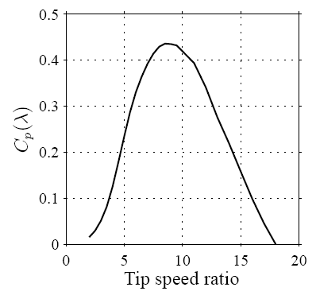
Power Coefficient
C_{p} (λ,β) - ratio of power from a wind turbine to the power available in the wind
β - pitch angle (rad)
λ - tip speed ratio
ω_{rmt} - speed of the wind turbine (rad/s)
R - radius of the wind turbine (m)
v_{w} - wind velocity (m/s)
Betz limit: C_{p} ≤ 59.3%
A. Petersson, Analysis, Modeling and Control of Doubly-Fed Induction Generators for Wind Turbines, Ph.D. Dissertation, Chalmers University of Technology, Sweden, 2005.

Slide 3
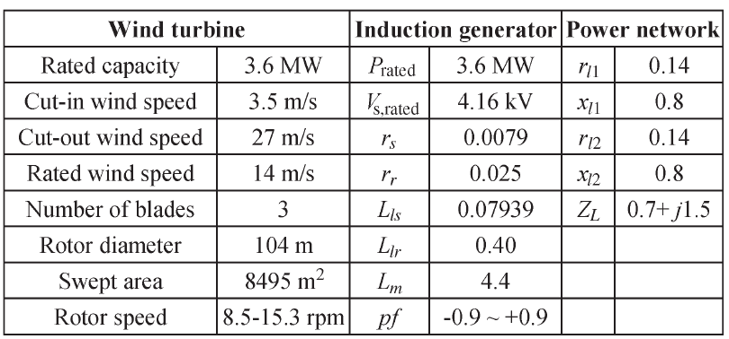
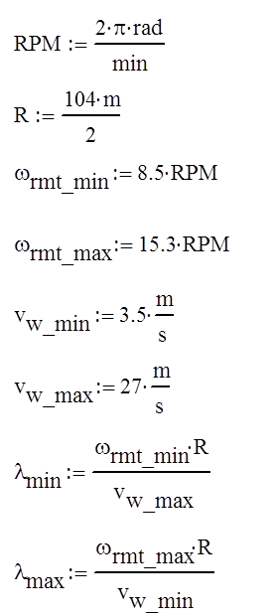
Example Wind Turbine
W. Qiao, G.K. Venayagamoorthy, and R.G. Harley, "Real-Time Implementation of a STATCOM on a Wind Farm Equipped With Doubly Fed Induction Generators," IEEE Transactions on Industry Applications, volume 45, number 1, pages 98-107, January/February 2009.

Slide 4
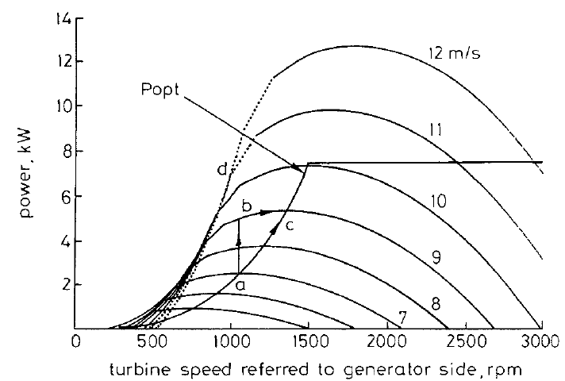
Power Versus Rotational Speed
constant pitch angle β
P = 6, f = 50 Hz
command P_{opt} from the wind turbine drive
limit command to rated power
above rated speed, use pitch angle to regulate speed
R. Pena, J.C. Clare, and G.M Asher, "Doubly fed induction generator using back-to-back PWM converters and its application to variable-speed wind-energy generation," IEE Proceedings - Electric Power Applications, volume 143, Issue 3, pages 231-241, May 1996.

Slide 5
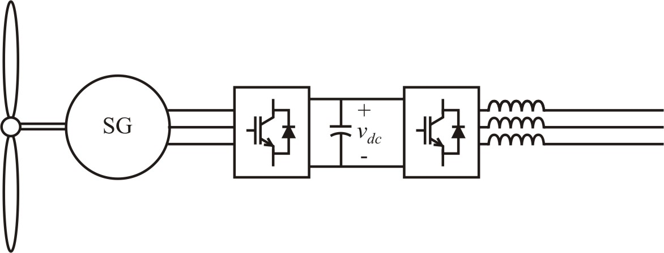
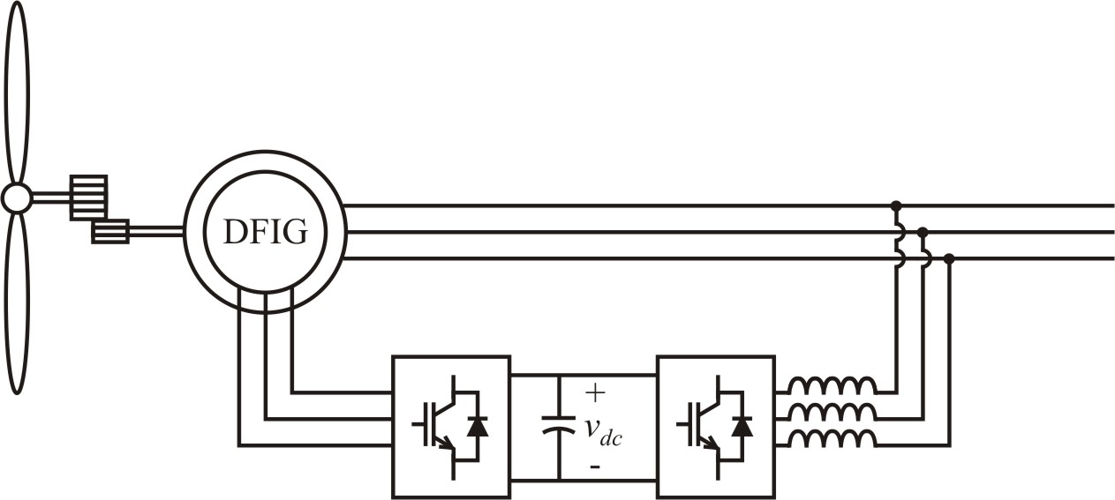
Wind Power System Diagrams
direct-drive synchronous generator
dual-fed induction generator (DFIG)

Slide 6
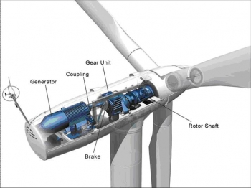
Wind Turbine Diagram

Slide 7
Wind Power Basics
Amount of energy harvested from the wind is express as a power coefficient which depends on the tip speed ratio and blade pitch angle
According to theory, the power coefficient is limited to 59.3%
Given the specific power coefficient curves for a particular wind turbine, the commanded power from the turbine drive can be set to the maximum power available for a given wind speed

Slide 8
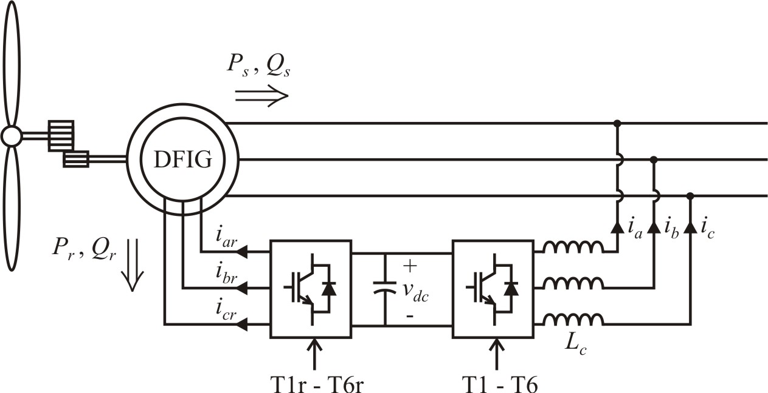
DFIG System
dual fed induction generator (DFIG)
or wound-rotor induction machine (WRIM)

Slide 9
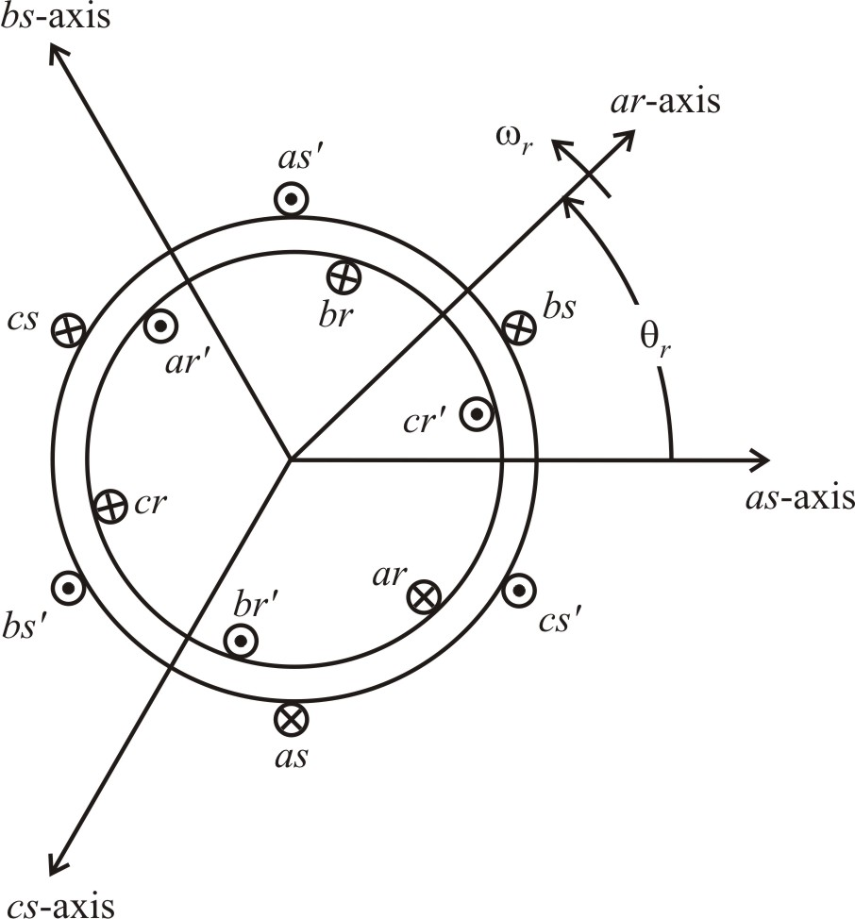
Symmetrical Induction Machines (Chapter 4)
voltage equations
typically wye connected windings

Slide 10
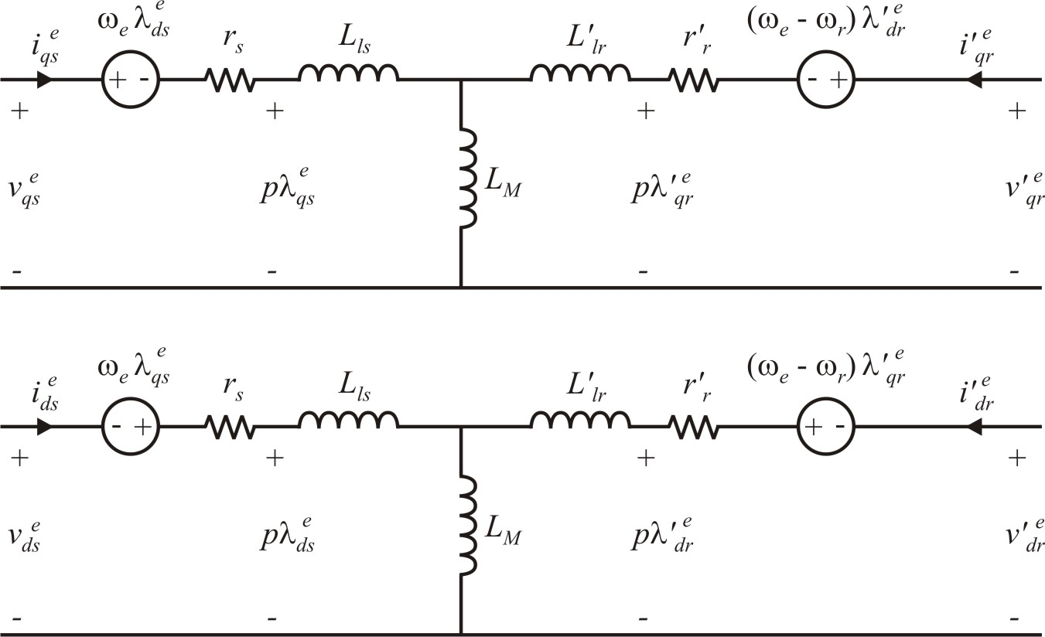
IM q-d Equivalent Circuit (Synchronous Reference Frame)
P_{s}, Q_{s}
P_{r}, Q_{r}

Slide 11
IM Stator Side Equations
steady-state, synchronous reference frame
substitute flux linkage equations into voltage equations
solve for stator currents

Slide 12
Stator Currents in Terms of Rotor Currents
in the synchronous reference frame
assuming that

Slide 13
Stator Side Power
stator power
in terms of rotor currents
Note: stator real power can be controlled by q-axis rotor current in the synchronous reference frame. Stator reactive power is controlled by d-axis rotor current.

Slide 14
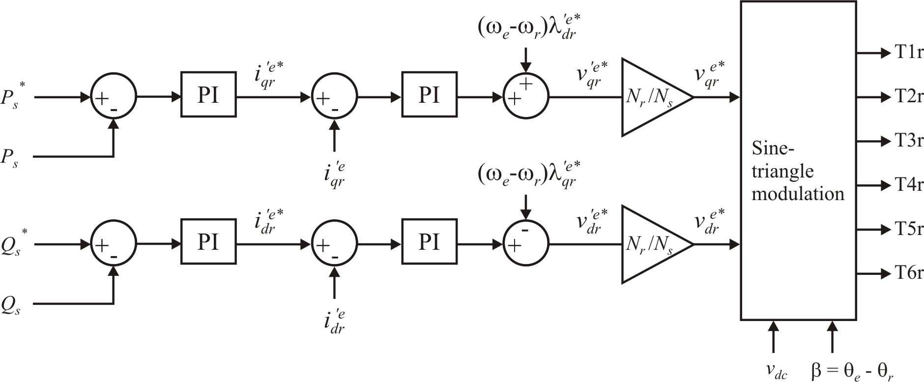
IM Rotor Side Converter (RSC) Control

Slide 15
Flux Linkage Calculations

Slide 16
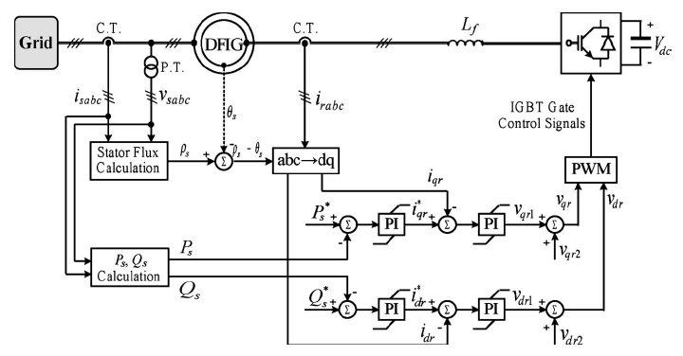
IM Rotor Converter Control
W. Qiao, G.K. Venayagamoorthy, and R.G. Harley, "Real-Time Implementation of a STATCOM on a Wind Farm Equipped With Doubly Fed Induction Generators," IEEE Transactions on Industry Applications, volume 45, number 1, pages 98-107, January/February 2009.

Slide 17
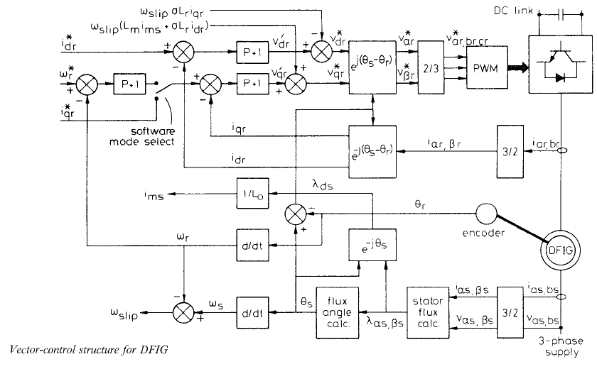
IM Rotor Converter Control
R. Pena, J.C. Clare, and G.M Asher, "Doubly fed induction generator using back-to-back PWM converters and its application to variable-speed wind-energy generation," IEE Proceedings - Electric Power Applications, volume 143, Issue 3, pages 231-241, May 1996.

Slide 18
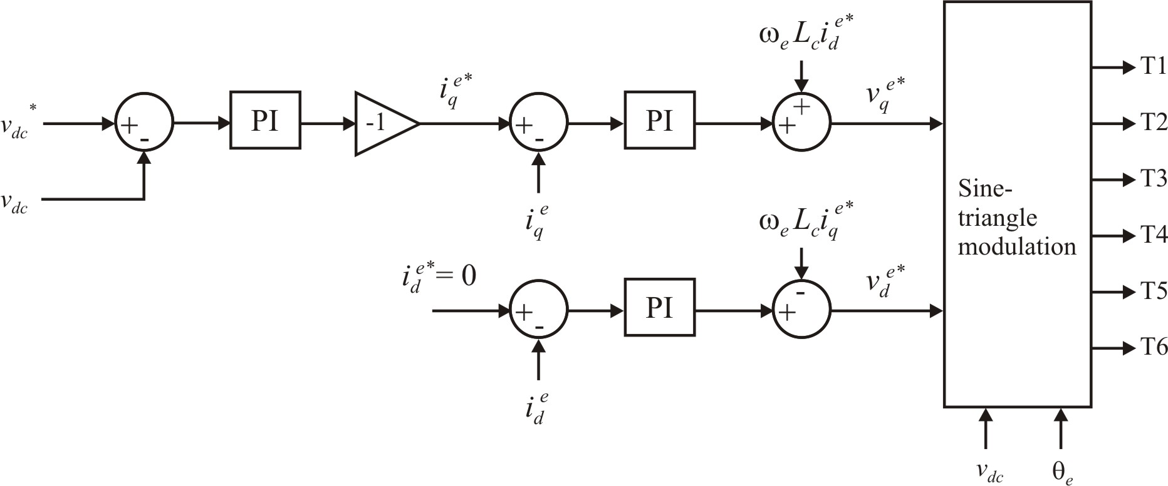
Grid Side Converter (GSC) Control
reactive power can also be controlled through the d-axis current

Slide 19
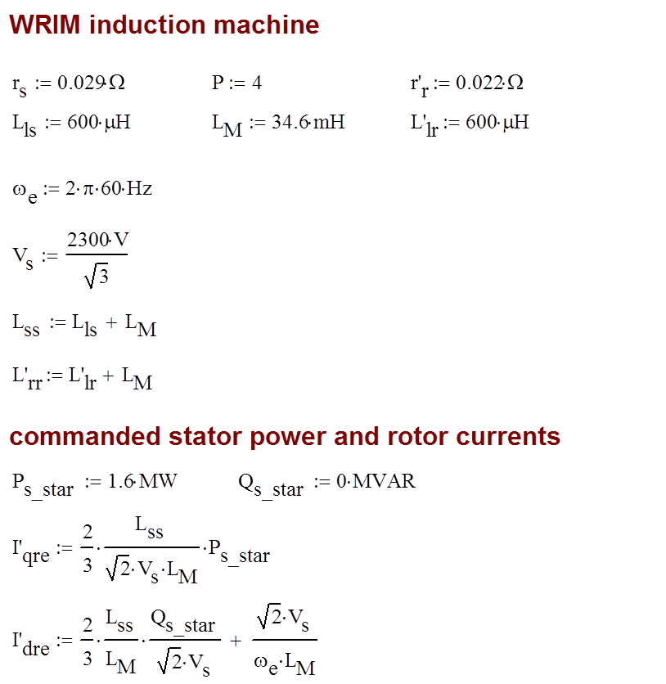
Example using 2250hp Machine from Book

Slide 20
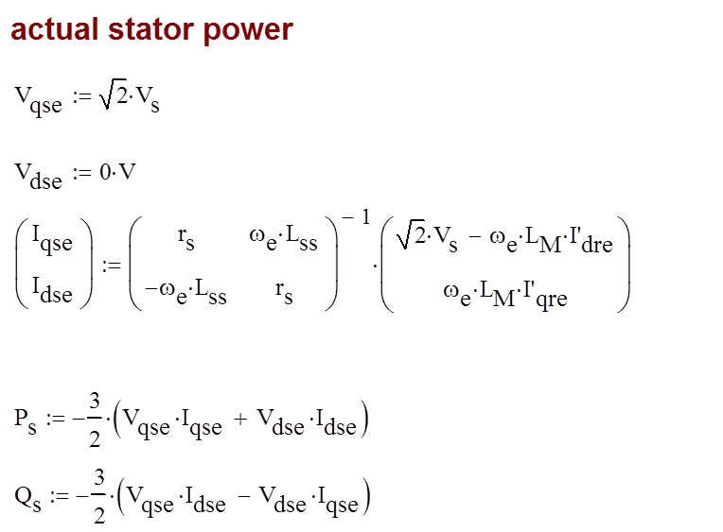

Slide 21
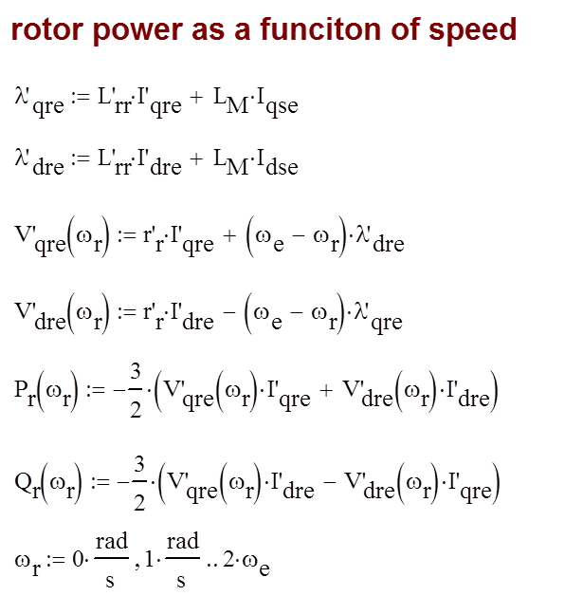

Slide 22
Stator and Rotor Power Versus Speed

Slide 23
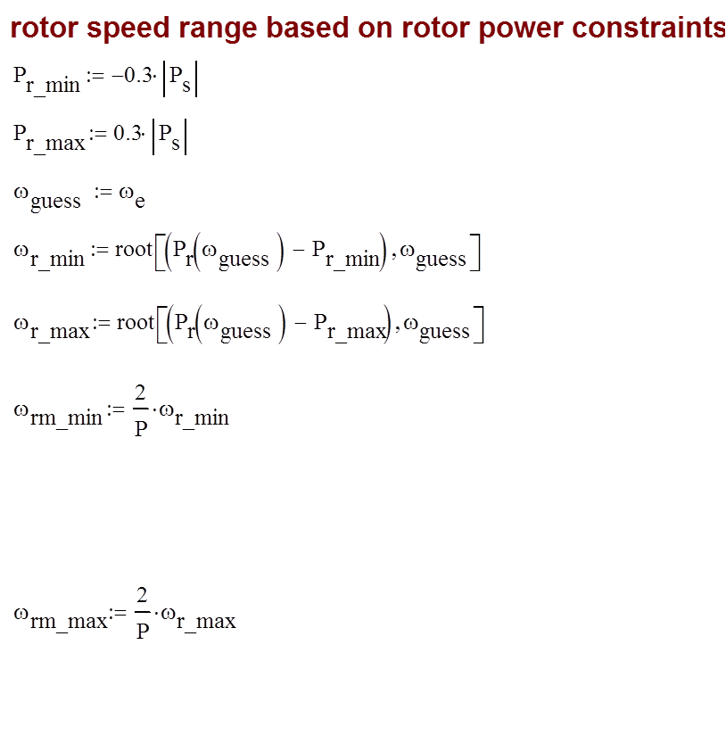

Slide 24
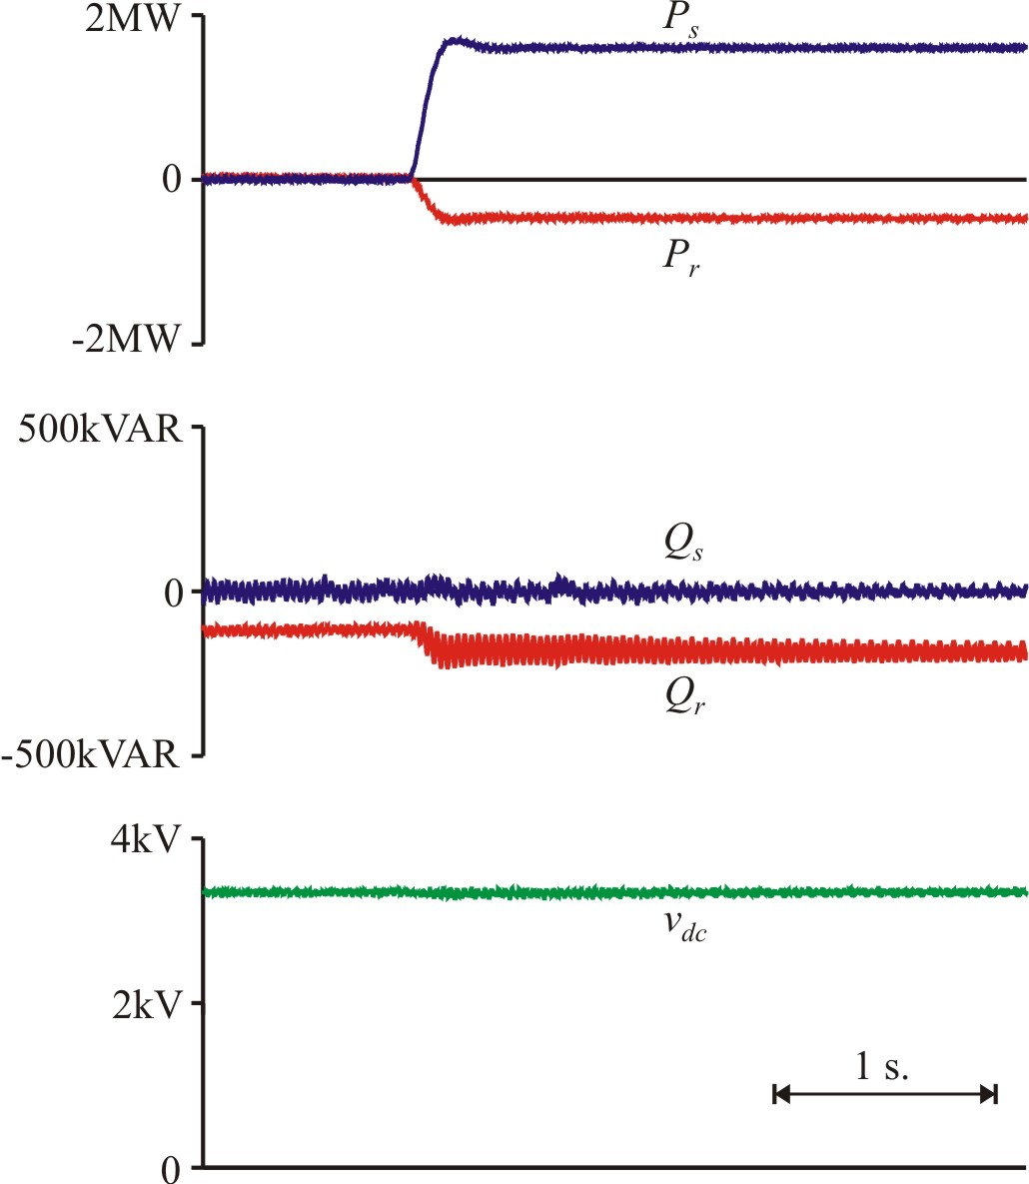
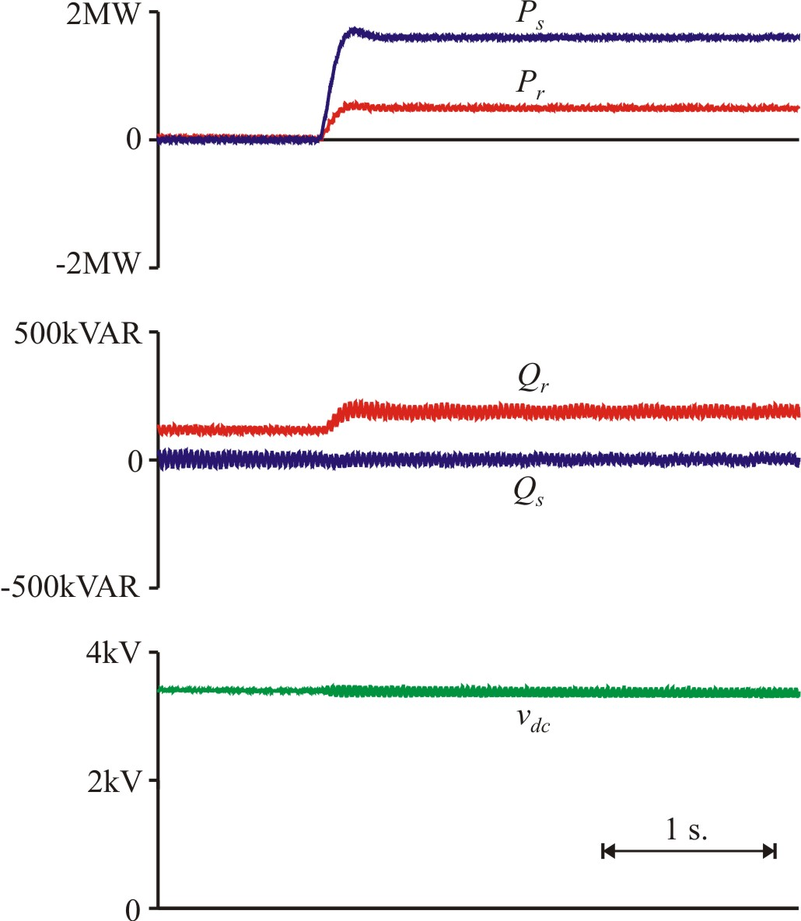
Simulated DFIG with Step in Commanded Power
L_{c} = 500 µH, v_{dc}* = 3700 V
ω_{rm} = 1278 r/min
ω_{rm} = 2348 r/min

Slide 25
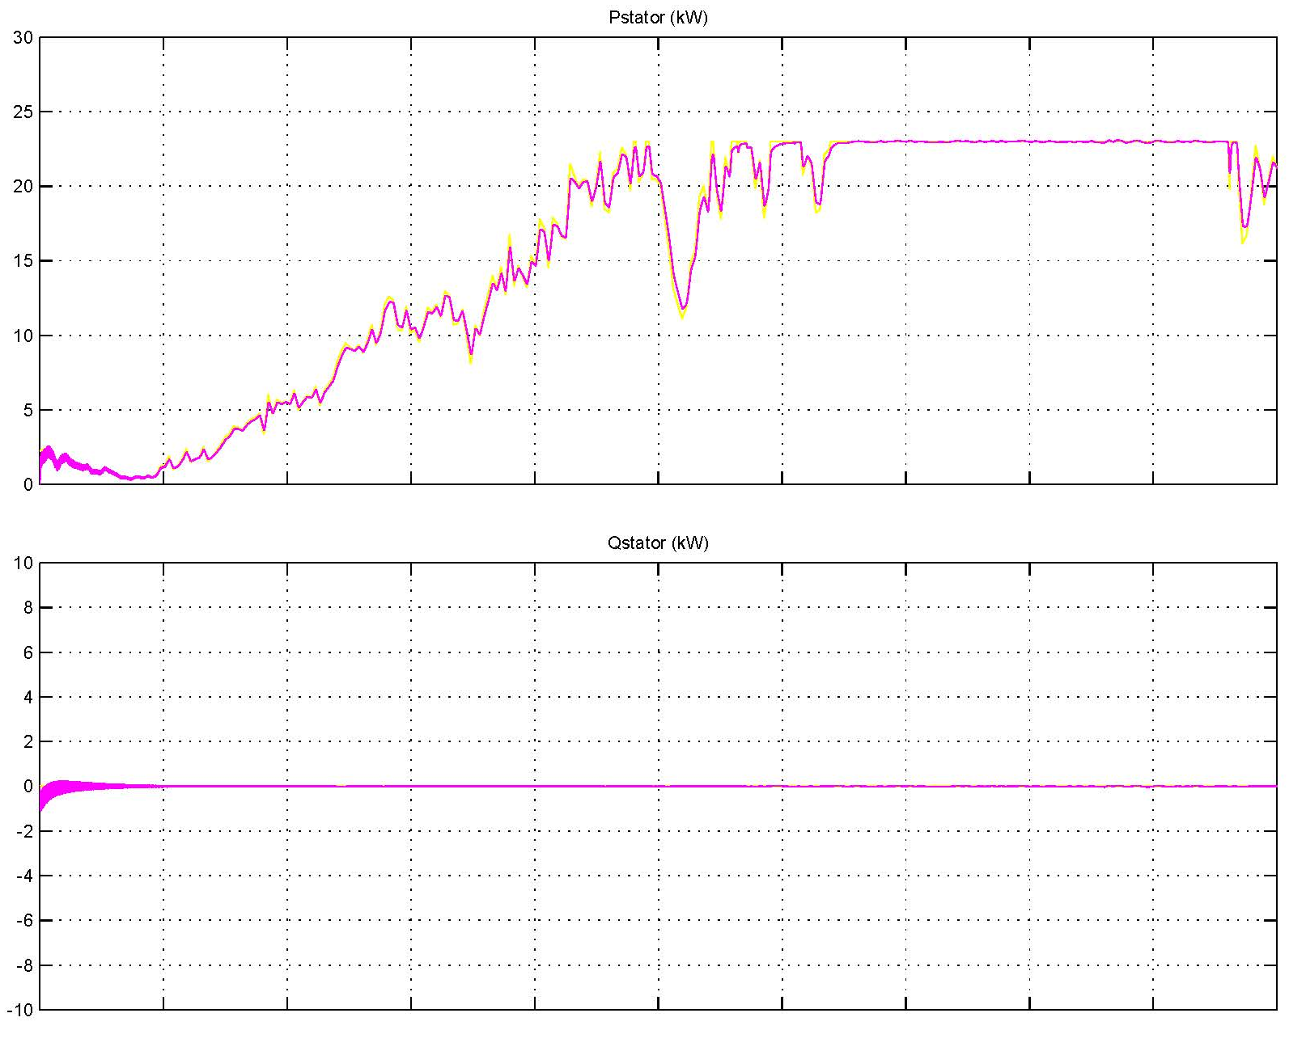
Example 30kW Machine with Wind Data

Slide 26
DFIG for Wind Power Applications
Stator real and reactive power can be controlled using the synchronous reference frame q- and d-axis rotor currents respectively
Grid side converter used to regulate the capacitor voltage
Typically the rotor power converter size is limited which leads to a practical limit on the speed range

